Slide 1
PROJECT : JUKEBOX
Under Guidance
of:
MRs. Mythreye Raghunathan
MRs. Shilpi Jain
Presentation BY :
Prashant Panth

Slide 2
CONTENTS:
1. INTRODUCTION
2. OBJECTIVES
3. MODULES
4. MySQL Database Queries
5. SOFTWARE - System REQUIREMENTS
6. FEATURES
7. CONCLUSION

Slide 3
INTRODUCTION:
Jukebox is a digital half automated music playing device, with which we can listen to any type of music.
They were first introduced in 1890 by Louis Glass and William S. Arnold in San Francisco.
Origin of name Jukebox is derived from the word Jook which means slangily dancing and enjoying wildly.
This Jukebox Project is to build a system which will let us perform some operations on audio files inside System.
We can browse through all available songs and playlists lists .
Aim is to create user friendly Jukebox Interface which is easy to access using Java program ,MySQL ,Audio Input Stream etc.

Slide 4
OBJECTIVES:
To create a proper Jukebox for various operations on Songs.
User can view Songs and Playlists.
User can add songs to Song List, and Playlists.
Traverse through Songs or Playlists according to user Choice.
User can search, listen songs by Title, Genre, Artist & Album.
User can select and choose any Song or Playlist.
It can perform operations on song like Play , Pause, Resume Next, Rewind and Stop, etc.
We can create a new Playlist also & add Song and Album to it.
In these tasks we will use Java Applications and MySQL Database.
We can also display contents of Playlist.

Slide 5
MODULES:
Add Song to Songs List
Search Songs by Ways
Display or View Songs
Create Playlists
Display or View Playlists
Add Song to Playlist
Add Album to Playlist
Display Playlist Content
Play, Pause Song & etc.

Slide 6
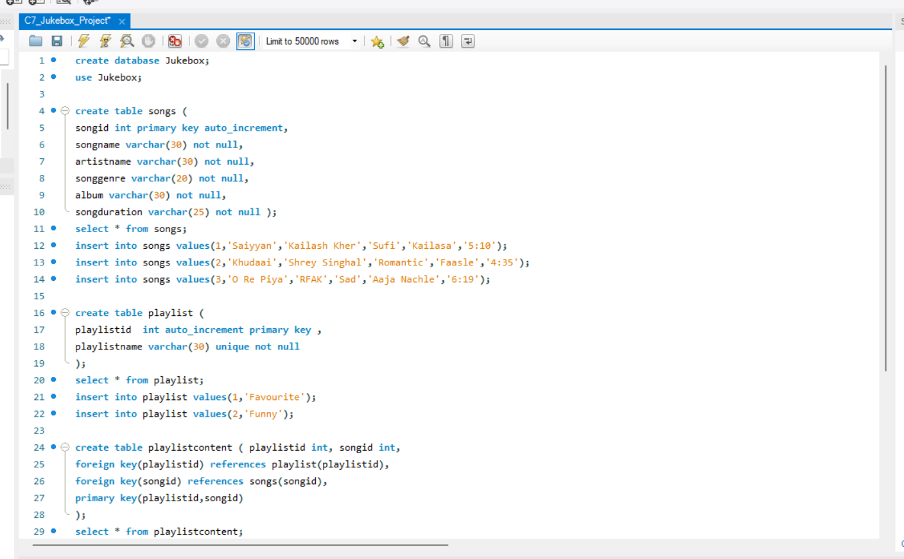
MySQL DATABASE QUERIES:

Slide 7
SOFTWARES – SYSTEM REQUIREMENTS :
WINDOWS 11 O.S
JDK 1.8
For Each LOOP
RDBMS
MySQL 8.0
JDBC API
COLLECTIONS FRAMEWORK
AUDIO INPUT STREAM

Slide 8
FEATURES:
FOR EACH – Provides way of iterating over a collection.
RDBMS - Sort of Database that stores and provides data access.
MySQL 8.0 – Use for the purpose of a web DataBase.
JDBC API – Provides universal data access from Java Programming Language.
COLLECTION FRAMEWORK- Use for many data manipulation operations.
AUDIOINPUT STREAM – Input Stream with a specified audio format and length.
OOPS – Has many benefits like Code Reusability, DRY (Don’t Repeat Yourself).
EXCEPTION HANDLING – To Handle Runtime Errors for smooth flow of code.
ADVANCED JAVA – Has many concepts and features which makes tasks easy.

Slide 9
CONCLUSION:
The JUKEBOX project is developed by using JDK 1.8 and Java API’s other concepts and Features.
This design concludes that our modern jukebox allows users to access music and Playlists according to your choice whether you want to search them by genre or by song name or artists or album name, other than OOPS ,we have also used Exception Handling, Generics, Advanced Java ,MySQL Connector/J which is a JDBC Type 4 Driver Implementing the JDBC 4.2 Specification and etc...

Slide 10

Thank You !
THE END

